Slide 1

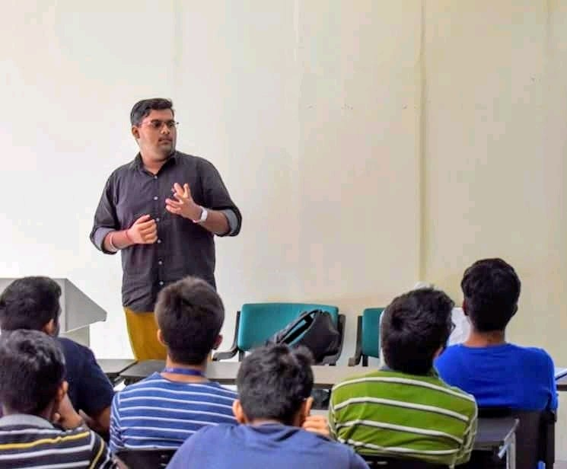

Azure
Fundamentals
Shubham Gupta
Beta Microsoft Student Partner
Google Code- in 19 Mentor
ML DL Enthusiast

Slide 2
Today’s Agenda
What is Cloud?
Why Cloud ?
What is Azure ?
What Resources does Azure offer?
Cloud Deployment Models
Types of Cloud Computing Services
Regions and Zones
Core Azure architectural components

Slide 3
Agenda Continue…..
Azure Government Services
Azure Subscription
Purchasing Azure Products and Services
Azure Free account
Pricing calculator
Azure cost management
Support plans
What next

Slide 4
What is Cloud?

Slide 5

Notes:
The ability to rent Computing Resources on demand is called Cloud

Slide 6
Why Cloud ?
Notes:
Basically there are four main reason to use cloud

Slide 7
High Availability
Scalability
Agility
Fault Tolerance
Disaster Recovery
Economies of Scale
Notes:
Cost Efficient
Moving to the cloud saves the upfront cost of purchasing, managing and upgrading the IT systems
Storage space
Businesses will no longer require file storage, data backup and software programs which take up most
of the space as most of the data would be stored in remote cloud servers
Fault Resilient
While using own servers, you need to buy more hardware than you need in case of failure. In extreme cases,
you need to duplicate everything. Moving to cloud eliminates redundancy and susceptibility to outages
Scalability
Using cloud computing, businesses can easily expand existing computing resources

Slide 8
High Availability
Expressed as a percentage
It’s the ability of a system to respond to users

Slide 9
99.99%
Four nines, 4 minutes per month

Slide 10
Scalability
The ability of a system to automatically grow and shrink based on application demand

Slide 11
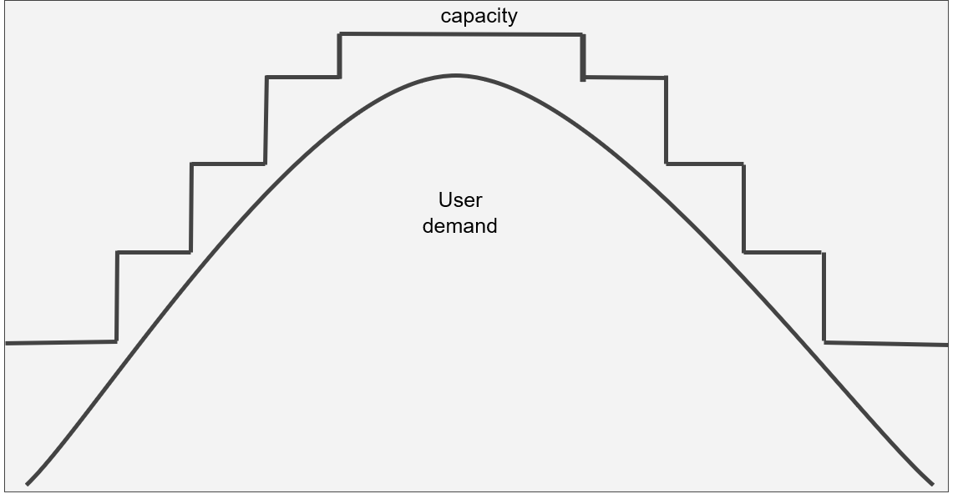

Slide 12
Agility
The ability to change rapidly based on changes to market or environment

Slide 13
Fault Tolerance
The ability of a system to handle faults like power, networking, or hardware failures

Slide 14
Disaster Recovery
The ability of a system to recover from failure within period of time

Slide 15
Economies of Scale
It’s cheaper for Microsoft to run a server than you can ever achieve yourself

Slide 16
Pay per minute
Pay per hour
Pay per execution

Slide 17

What is Azure?

Slide 18
Microsoft Azure
Set of cloud services
Build , manage and deploy applications

Slide 19
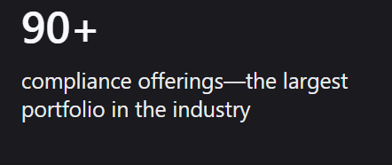
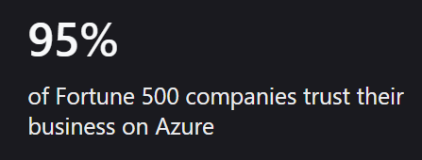
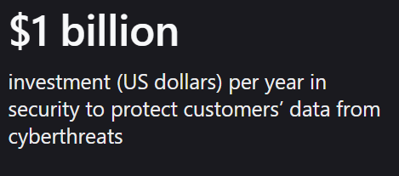

Slide 20
What Resources does Azure offer?

Slide 21
Virtual Machines
Unlimited Storage
Database
Content delivery Services
Big Data – Hadoop
Media Services
Machine Learning
Cognitive Services
Chat Bots

Slide 22
1000+
Azure Service options

Slide 23
Cloud Deployment Models
Notes:
Three are three types of cloud deployment model

Slide 24
Public Cloud
A type of hosting which cloud services are delivered over a network for public use.
Customers do not have any control over the location of the infrastructure.

Slide 25
Private Cloud
A cloud infrastructure that is solely used by one organization.
It gives organizations greater control over security and data

Slide 26
Types of Cloud Computing Services

Slide 27
Infrastructure-as-a- Service (IaaS)
Platform-as-a-Service (PaaS)
Software-as-a-Service (SaaS)

Slide 28
IaaS
Cloud-based services
pay-as-you-go for services such as storage, networking, and virtualization

Slide 29
PaaS
Hardware and software tools available over the internet.

Slide 30
SaaS
Software that’s available via a third-party over the internet.

Slide 31
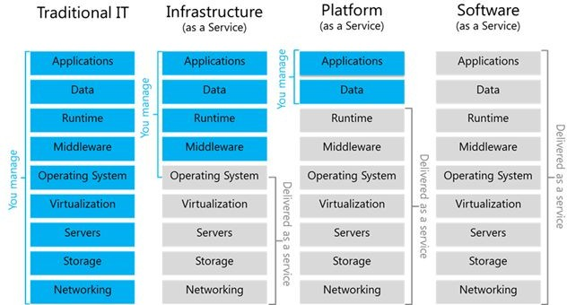

Slide 32
Regions

Slide 33
54
Regions - not all accessible by everyone

Slide 34
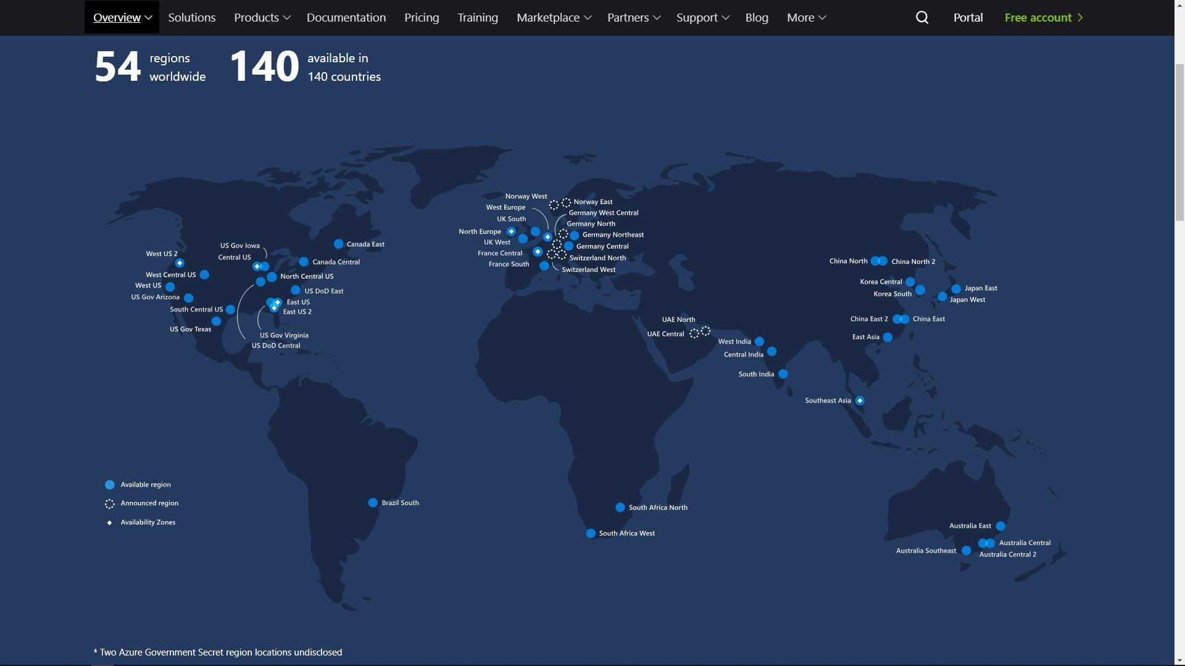

Slide 35
Availability Zones

Slide 36
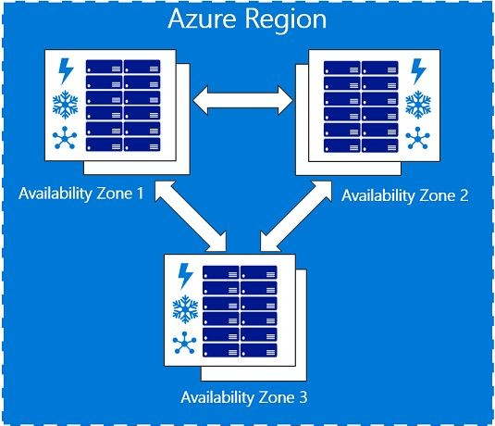

Slide 37
Core Azure architectural components

Slide 38
Storage
Azure Storage
Managed Disk
Backup and Recovery Storage

Slide 39
Compute
Virtual Machines
App Service
Functions
Virtual Machine Scale Sets

Slide 40
Networking
Virtual Network
Load Balancer
VPN Gateway
Application Gateway
Content Delivery Network

Slide 41
Azure Information
Protection (AIP)

Slide 42
Apply labels to emails and documents
i.e. Conﬁdential, Super Conﬁdential, Top Secret
Used to protect documents from being viewed, printed and/or shared
privacy.microsoft.com

Slide 43
Azure Government
Services

Slide 44
Separate Account
For US government agencies - federal, state and local

Slide 45
Azure Subscription

Slide 46
Subscription is a billing account
Users have access to one or more subscriptions, with different roles
All resources consumed by a subscription will be billed to the owner

Slide 47
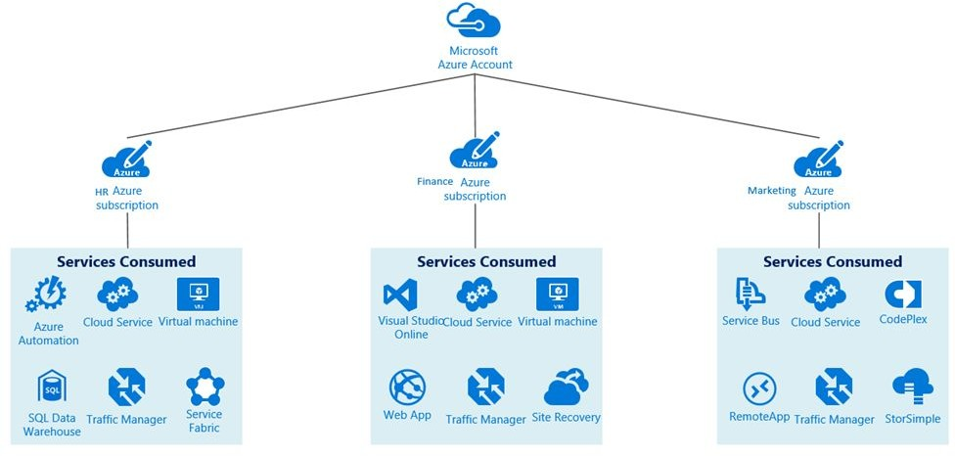

Slide 48
Purchasing Azure Products and Services

Slide 49
Purchase from Microsoft
Pay as you go
Enterprise Agreement

Slide 50
Purchase from a Microsoft Partner
Microsoft Cloud Solution Provider (CSP)

Slide 51
Azure Free account

Slide 52
http://azure.microsoft.com/free
US $200 credit for the ﬁrst 30 days
12 months of free services
Some services are always free

Slide 53
Free services
Resource groups
Free-tier web apps (up to 10)
Azure Active Directory (basic) Network security groups
Virtual network (up to 50) Load balancer (basic)

Slide 54
Pay per usage services
Functions
Logic Apps
Storage (pay per GB) Outbound bandwidth
Cognitive Services API

Slide 55
Pay for time (per second)
Per second billing means billing stops when the VM is stopped

Slide 56
Pay for bandwidth
First 5 GB is free
Inbound data is free
1 PB of data transfer = $52,000 approx.

Slide 57
Demo :
How to create a VM ?

Slide 58
Pricing Calculator

Slide 59
https://azure.microsoft.com/en-ca/pricing/calculator/
Estimates are hard to make 100% accurate

Slide 60
Azure Cost Management

Slide 61
Free tool inside Azure to analyze spending
Analyze spending over time

Slide 62
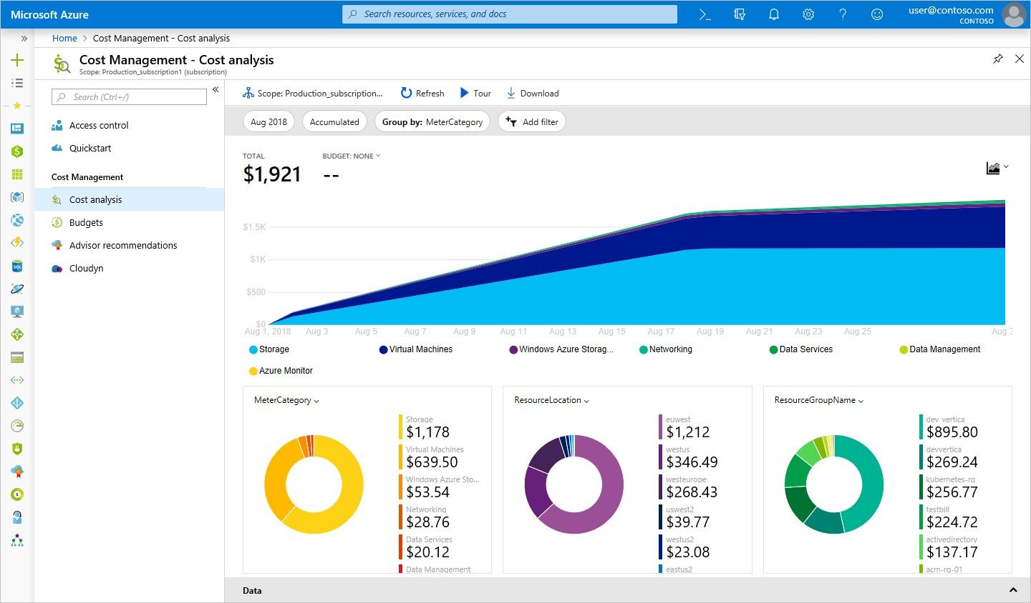

Slide 63
Support plans

Slide 64
Levels of Azure Support
Basic - free and included in all plans
Developer - non-production environments
Standard - production environments
Professional Direct - business critical
Premier - multiple products, including Azure

Slide 65
Basic Support
Self-help support
Documentation
Azure Advisor recommendations
Service Health dashboard and Health API

Slide 66
Developer Support
Business hours access to support engineers via email
Unlimited contacts
One day response time (< 8 hours) General architectural guidance
$29 / month

Slide 67
Standard Support
24 x 7 access to support engineers by phone and email
Unlimited contacts / cases
Sev C support (< 8 hours), Sev B (< 4 hours), and Sev A (< 1 hour) General architectural guidance
$100 / month

Slide 68
Professional Direct Support
24 x 7 access to support engineers by phone and email
Unlimited contacts / cases
Sev C support (< 8 hours), Sev B (< 4 hours), and Sev A (< 1 hour) Architectural guidance on best practices
$1,000 / month

Slide 69
Premier Support
Speciﬁc architectural support such as design reviews, performance tuning, etc Technical account manager, including service reviews, reporting
“Contact us”

Slide 70
https://azure.microsoft.com/en-in/support/plans/response/

Slide 71
What Next ??

Slide 72


Slide 73
Exam AZ-900:
Microsoft Azure Fundamentals
https://docs.microsoft.com/en-us/learn/paths/azure-fundamentals/

Slide 74
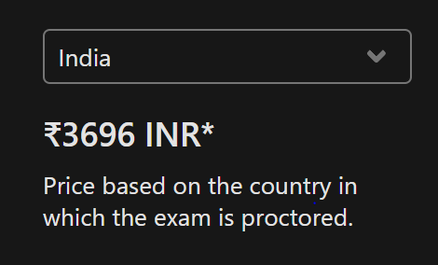
https://docs.microsoft.com/en-us/learn/paths/azure-fundamentals/

Slide 75
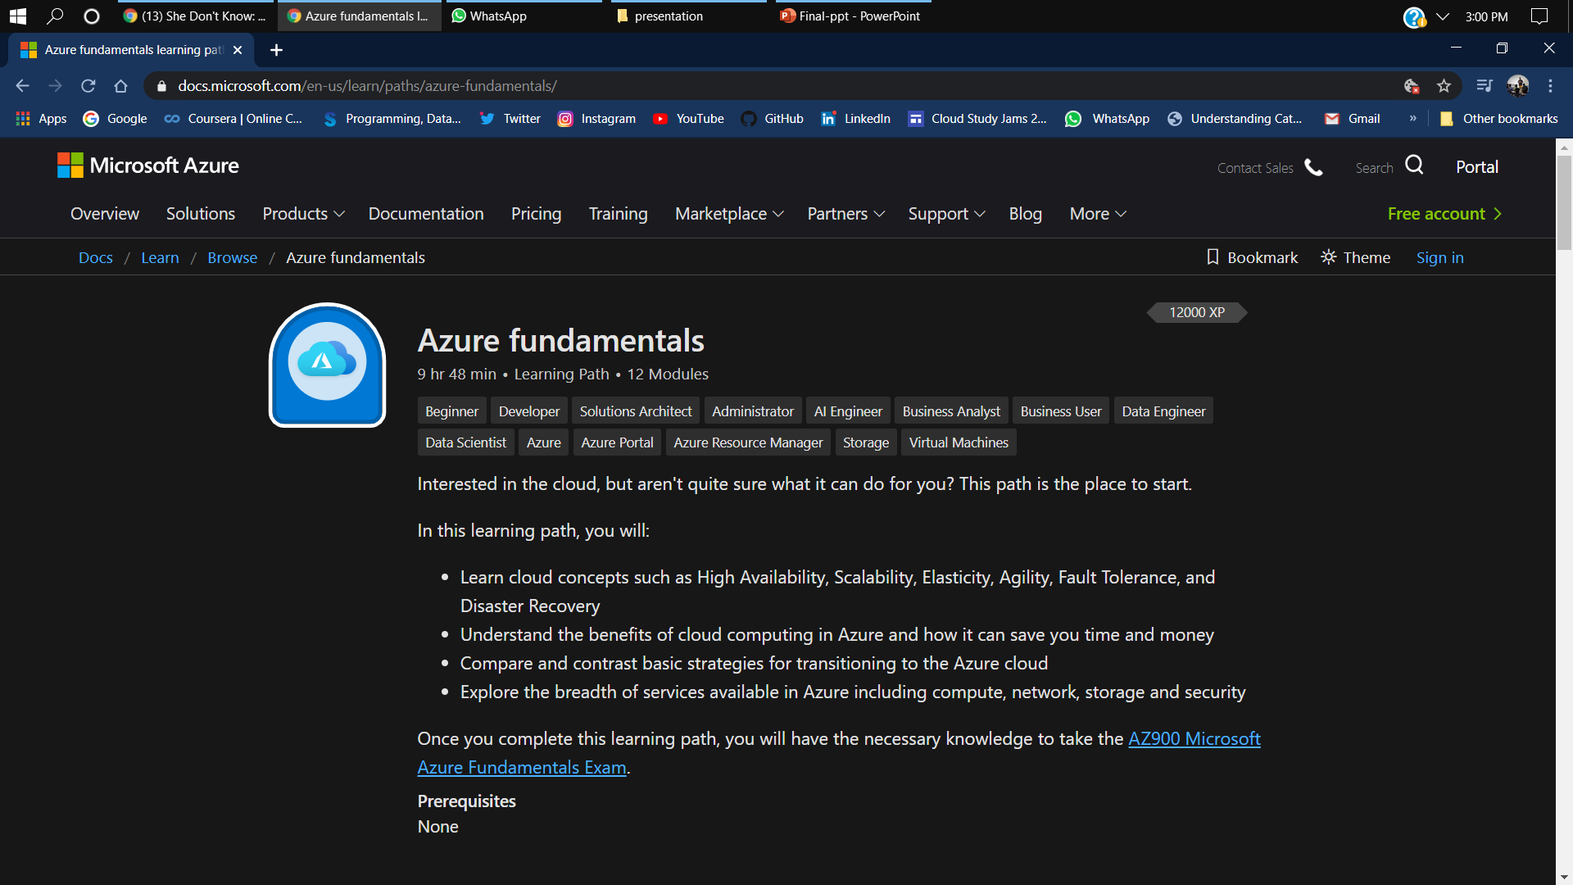

Slide 76

Get..

Slide 77
Thank You

Slide 78



Want to connect with me ?
/shubham15gupta09
/shubham15gupta09
/shubham15gupta0

